Slide 1


Getting Started with MongoDB

Slide 2
MongoDB as a Service
You can host your web app on the cloud instead of on your own dedicated server
You can also use a database hosted by a cloud service provider, rather than setting up and maintaining your own database server
Key benefits:
Cheaper than having your own database server
The cloud service provider deals with the configuration, backup, maintenance, security, etc.
Quick and easy
Notes:
It is often cheaper than having your own database server because you only pay for what you use.
The cloud service provider deals with all the hassle of ensuring the configuration, backup, maintenance, security, etc of the database server.
It is quick and easy to start using a database with minimal configuration.

Slide 3
MongoDB as a Service
We will be using MongoDB’s Database as a service solution: Atlas
Download and install MongoDB on your local machine so that you can use mongo, the administrative shell,
Use Atlas to create and host a MongoDB on the cloud and
Use Mongo to access and manipulate your database cluster on Atlas.

Slide 4
Install MongoDB
Download it from MongoDB’s download center
Follow the installation instructions
Add the mongo executable to PATH, so the commands are accessible from outside the MongoDB bin folder
Check that the Mongo shell has been correctly installed by typing mongo --version in your command line interface
Notes:
Once MongoDB has been installed, do the following:
Step 1. Add the mongo executable to PATH, so the commands are accessible from outside the MongoDB bin folder.
To do this: Search for your MongoDb installation bin folder and copy the path (e.g.: C:\Program Files\MongoDB\bin). Right click My Computer > Properties > Advanced system settings > Environment Variables > System variables > Look for "Path" > Edit > New > Paste in the path to your Mongodb bin folder > Restart your terminal. More information about this step here.
Step 3. Check that the Mongo shell has been correctly installed by typing “mongo --version” in your command line interface.

Slide 5
Setup MongoDB Atlas
Go here and enter your information
You will be taken to the “Create New Cluster” page
Under Cloud provider & Region, select “aws” and any “free tier region”
Under “Cluster Tier” select the free M0 option
You can rename your cluster under “Cluster Name”.
Click on the “Create Cluster” button at the bottom of the page to create your cluster.

Slide 6
Setup MongoDB Atlas
Security settings:
IPs that are allowed to access your cluster are listed under the “Security” tab in the “IP Whitelist”
Click on the “Security” tab and select “IP Whitelist” from the menu, then click on the “+ Add IP Address” button
In the “Add Whitelist Entry” popup window, click on the “Allow Access From Anywhere” button and then click “Confirm”
Notes:
It is not good practice to allow all IP addresses to access your database for obvious security reasons, but for the purposes of the next few tasks, we are going to ask you to do this. The reason for this is that we are going to ask you to give your mentor access to your database and you don’t have your mentor’s IP address. In practice, however, it is advisable to have a limited IP whitelist.
If your machine is protected by a firewall, you also have to ensure that this doesn’t block access to Atlas. Atlas servers run on port 27017 on Amazon AWS.

Slide 7
Setup MongoDB Atlas
Manage users and teams:
You have to manage who is able to access your database and what they can do with your database
Select “Users and teams” and then click on the “Add users and teams” button.
Invite your mentor to be a user of your database by entering their email address

Slide 8
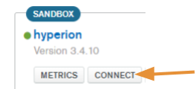
Access the Database on the Cloud using the Mongo Shell
Remember: Mongo is the administrative shell used to run instructions on your MongoDB server.
Select “Connect” to find the connection string.

Slide 9
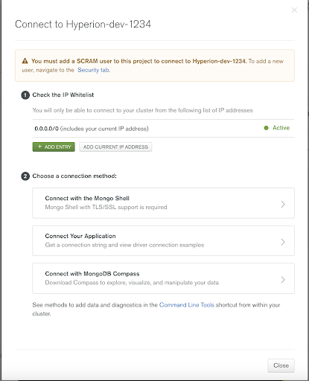
Access the Database on the Cloud using the Mongo Shell
The following popup window will appear
Select “Connect with the Mongo Shell”
Then, select “I am using shell 3.6 or later”, and copy-paste the connection string that appears there into your command line interface

Slide 10
Create a Database
Type the following using the mongo shell: use test where test is the name of the database. If the database does not already exist, this instruction will create it
MongoDB Compass: allows you to interface with your database
Quit Mongo: type quit() into the mongo shell

Slide 11
Database Interaction

Slide 12
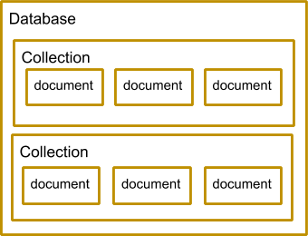
Mongo Shell Basic Commands
show dbs;
use db_name;
show collections;
db.dropDatabase();
Notes:
show dbs;
This command is used to list all the databases in your cluster.
use db_name;
This command is used to select a database. Before you can manipulate a database, you need to select it. This command is also used to create a database (as you did in your previous task). If the database does not already exist, this instruction will create a database with the name specified in the command. The rules regarding which special characters are not to be used in naming your database vary depending on the operating system your database is running on. You should not use the following characters in your db name: /\. "$*<>:|?
show collections;
This command shows all the collections in the previously selected database. A collection is a grouping of related documents and is equivalent to a table in a relational database. If you were creating a database for a company that sells cars, for example, you could have a car collection, customer collection and shop collection.
db.dropDatabase();
This command is used to delete a database. Before you use this command though, you need to make sure you have selected the database you would like to delete using the ‘use’ command shown previously. If you are not sure which database you are currently working with, you can simply type the command ‘db’ into your mongo shell and it will display the name of the database that you have selected.

Slide 13
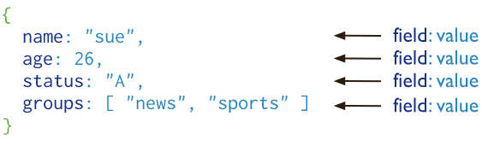
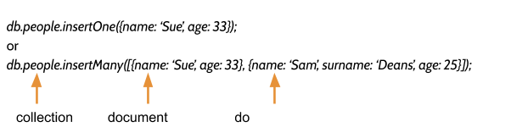
CRUD Operations
Create:
Image source: https://docs.mongodb.com/manual/core/document/
Notes:
Once you have created a database, you need to insert collections and documents into the database. As you know, a collection is a grouping of BSON documents. A BSON document is basically a JSON document that is stored in such a way that it allows you to store more ‘type’ information about your data. For example, JSON files don’t recognise ‘date’ as a type, whereas BSON documents do. As you can see in the image below, documents store information using key-value pairs. Each document in a collection can have a slightly different structure.
Note that not all the documents in your collection need exactly the same format. See how the BSON document for Sue only stores name and age, whereas the BSON document for Sam stores name, surname and age information. If the collection you specify in the insertOne or insertMany command does not exist, MongoDB will create the collection for you. Every document needs a unique identification. In MongoDB the field _id must be specified for each document. If you don’t explicitly specify an _id field when you insert a document, MongoDB will automatically generate one for you.

Slide 14
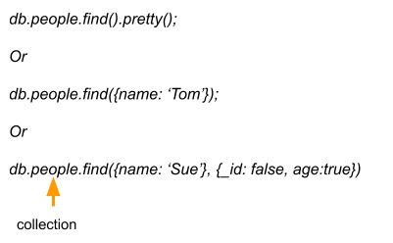
CRUD Operations
Read:
Notes:
The pretty() method is used to make the output more readable. The find command can be used without it.
When you specify find without any arguments, all documents in the collection will be returned.
You can also pass one or more key-value pairs as shown in the second code example, which will then find all documents that match the criteria specified. E.g. in the second code example above, the find command will find all documents where the person has the name, Tom, as well as all the information contained in all those documents, including the _id for each document.
You often do not want to read or display all the information in a document. For example, you may not want a user to see the _id value for each document. You can, therefore, also pass the find() method a second argument set as shown in the third example above. The arguments in the second set of curly brackets ({_id: false, age: true }) specify which fields will be retrieved and which won’t be. In this example, the _id won’t be output but the age field will.
You can also use the findOne() method instead of the find() method. findOne() will return only the first document that matches the specified criteria.

Slide 15
CRUD Operations
Update:
db.people.update({name: ‘Sue’}, {age: 34, name: ‘Sue’})
Or
db.people.update({name: ‘Sue’}, {$set: {age: 34}})
Or
db.people.update({name: ‘Sue’}, {$set: {name: ‘Susan’}}, {multi: true})
Notes:
Compare the first two commands in the code above. If you specify update without using the $set keyword, the entire document will be updated (as in the first command). However, if you use the $set keyword only the field specified will be updated and the other fields will remain the same. If you pass the third argument {multi: true} (as in the third command), then all documents that match the specified criteria will be updated. With the latest versions of MongoDB, you can use updateOne() and updateMany() commands. See the recommended reading for this task for more on this and other commands.
Be careful when you use the update command! Fields not defined in the update section will be removed from the document. Similarly, if you specify fields that were not previously part of your document with the update command, new fields will be added to your document.

Slide 16
CRUD Operations
Delete:
db.people.remove();
Or
db.people.remove({name: ‘Sue’})
Or
db.people.remove({name: ‘Sue’’}, true)
Notes:
If you issue the remove() command without passing any arguments (as in the first example), all documents in the collection will be removed. If you pass one argument (as in the second example) all documents with the specified criteria will be removed. If you pass the value ‘true’ as a second argument (as in the third example) only the first document that meets the specified criteria will be removed. Instead of using the remove command, you can also use the deleteOne() or deleteMany() command with the latest versions of MongoDB. See the recommended reading for this task for more on this and other commands.

